Slide 1
Predicting High-Traffic Recipes
- Vaidhavi Borkar

Slide 2
Objective
Business Goal: Identify which recipes are likely to generate high traffic on our website to optimize content and increase user engagement.
Project Goal: Develop a model that can accurately predict high-traffic recipes to aid in strategic content placement.

Slide 3
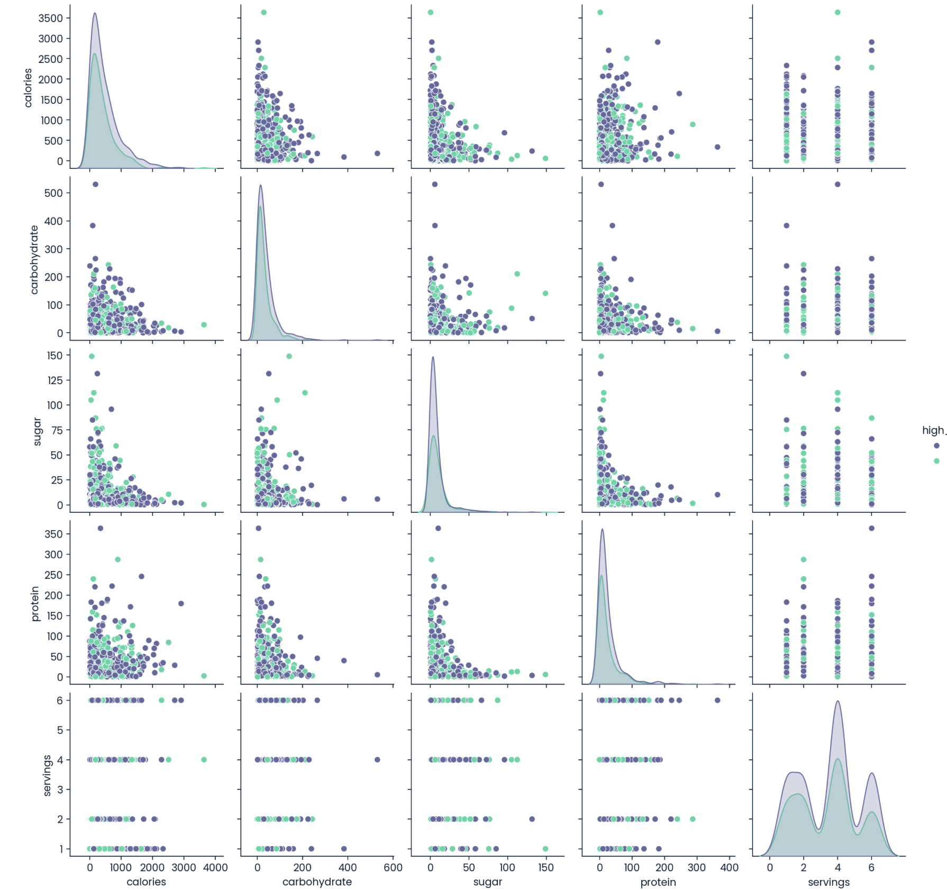
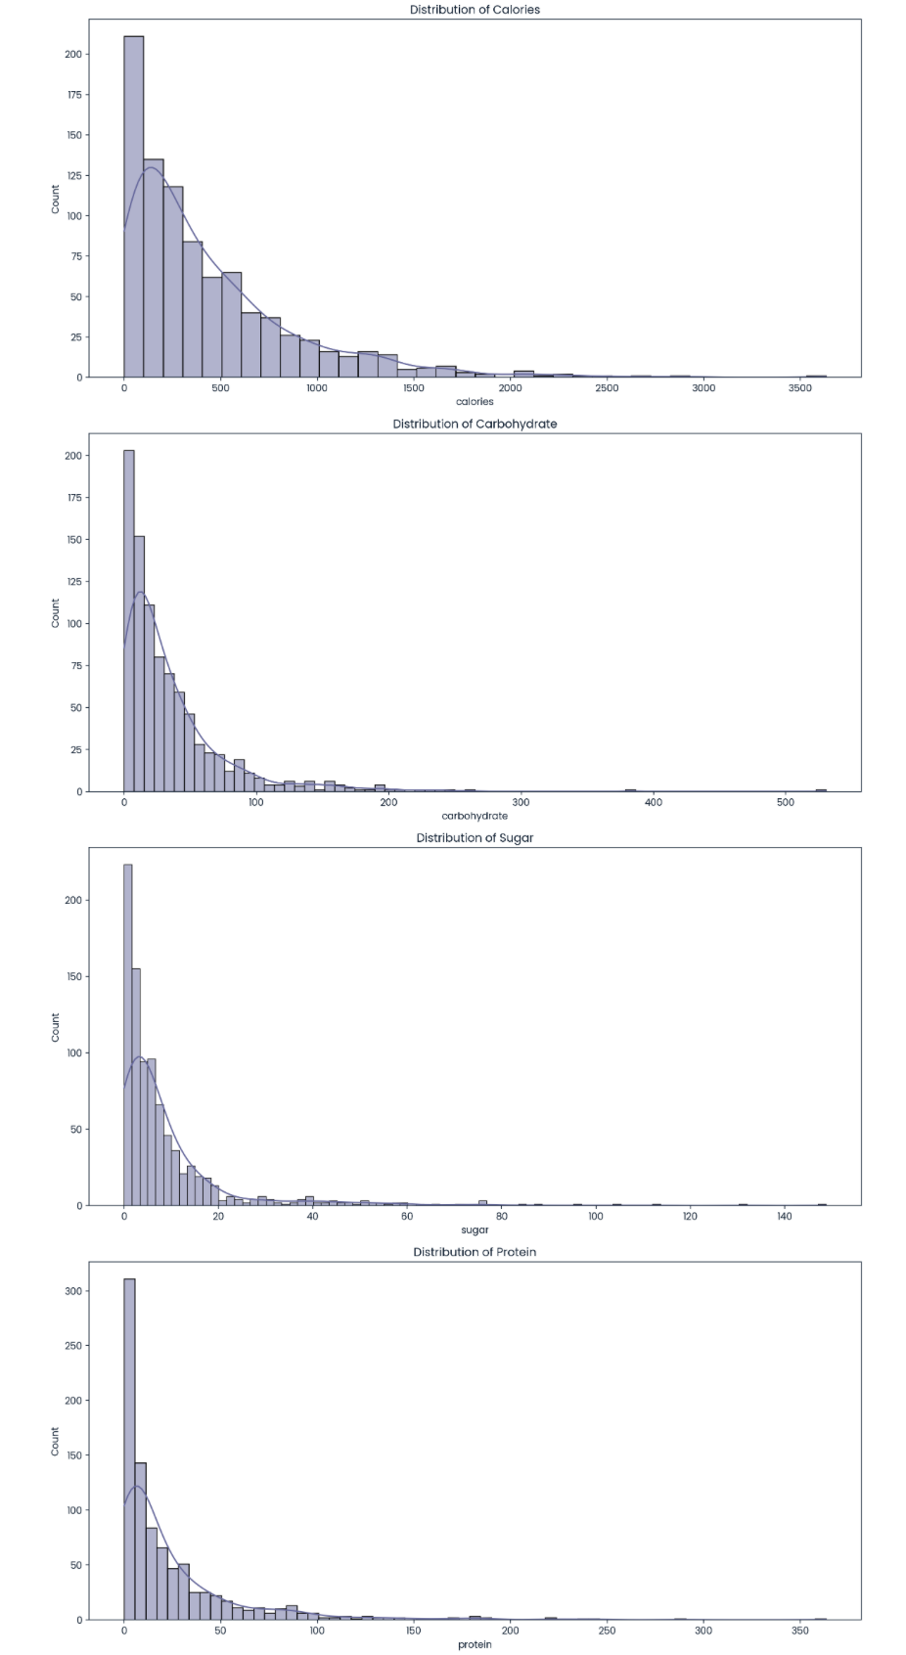
Cleaning the data

Slide 4
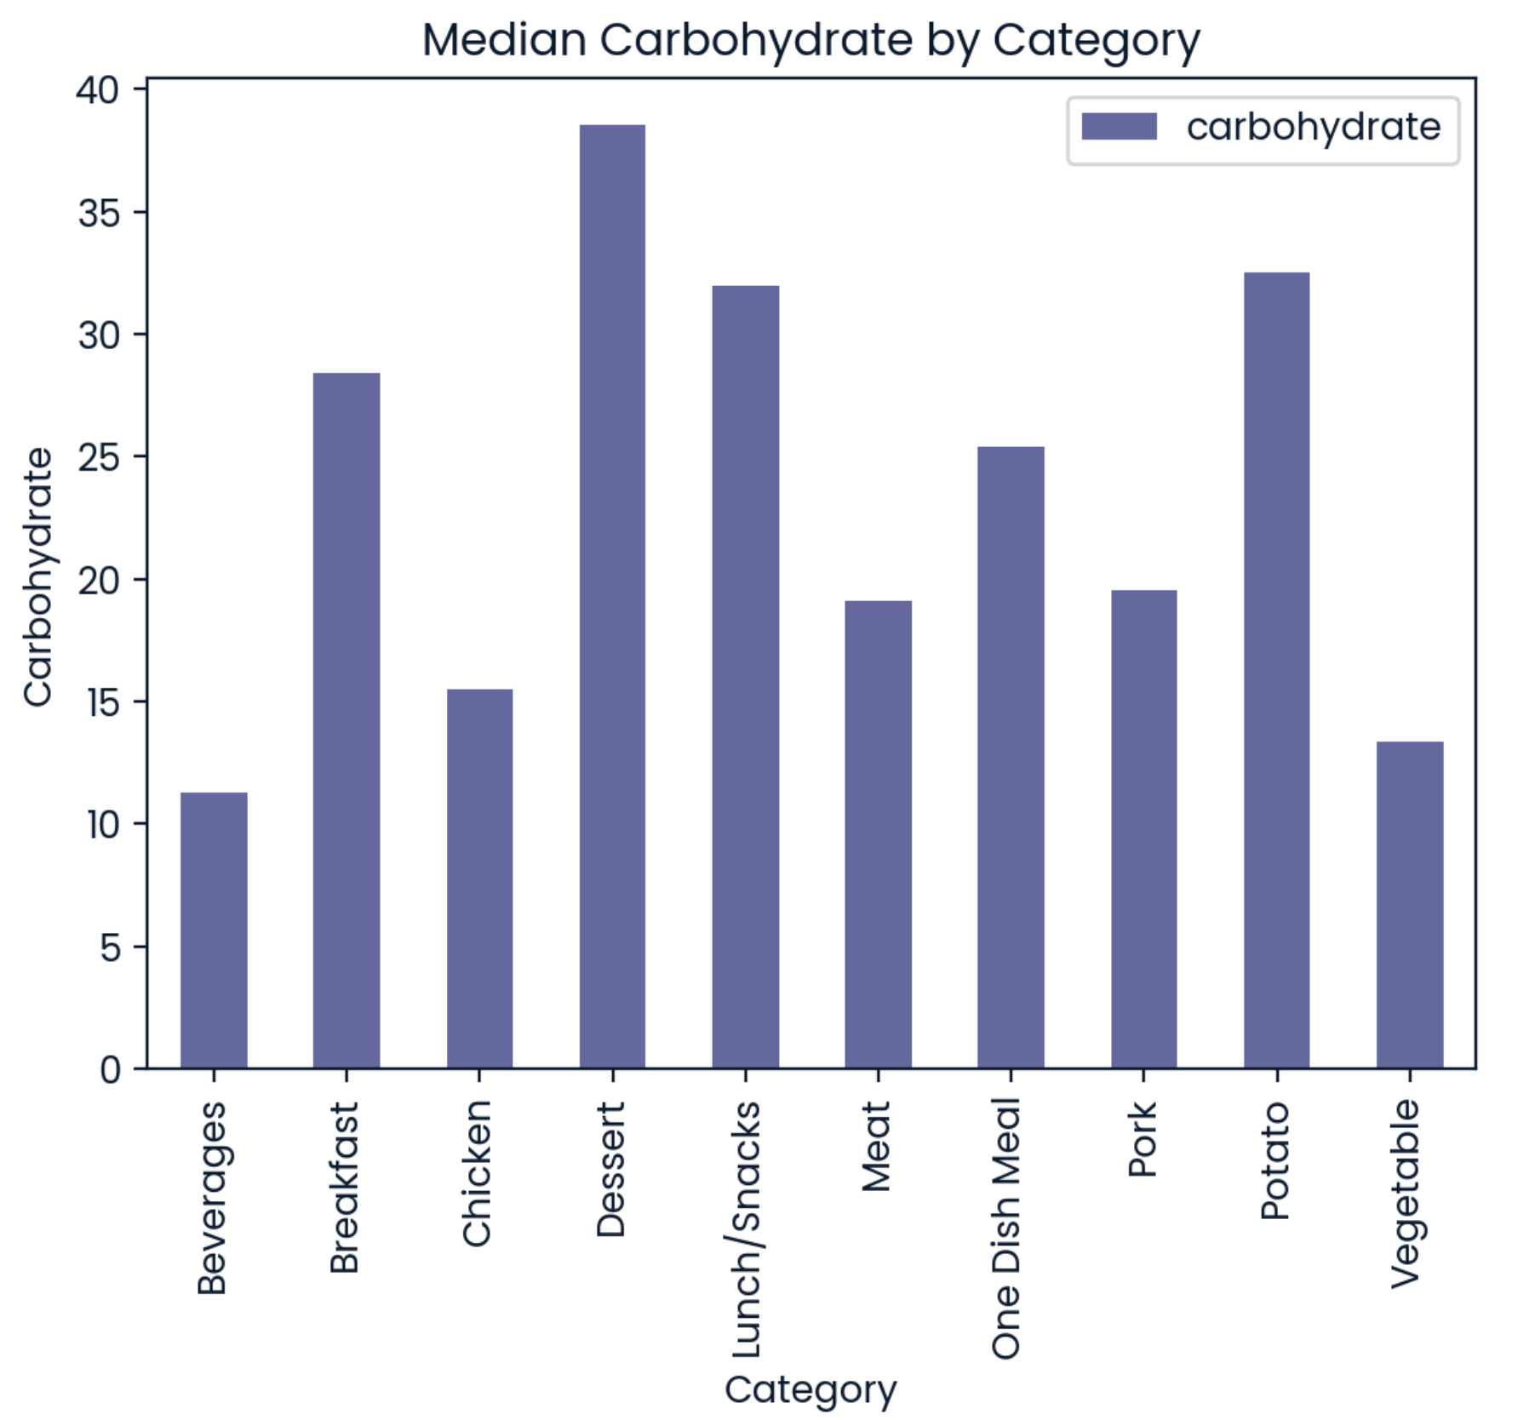
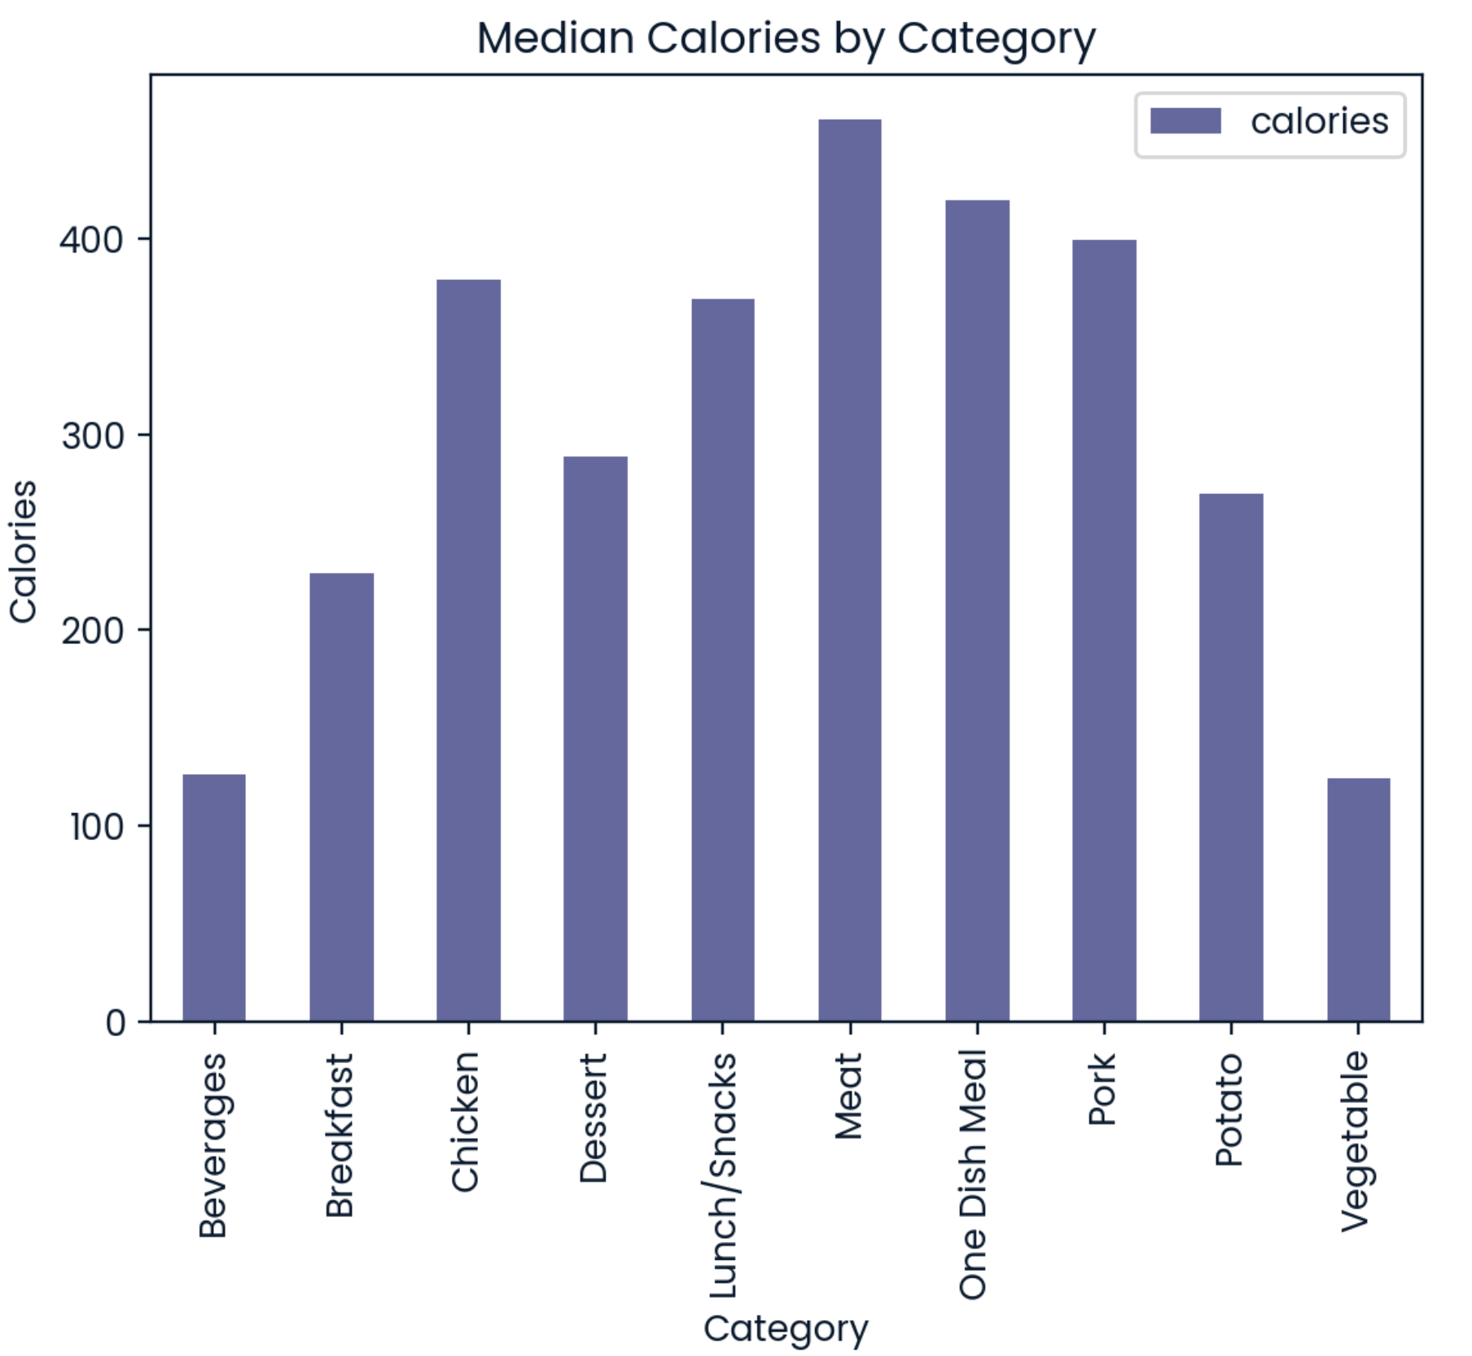
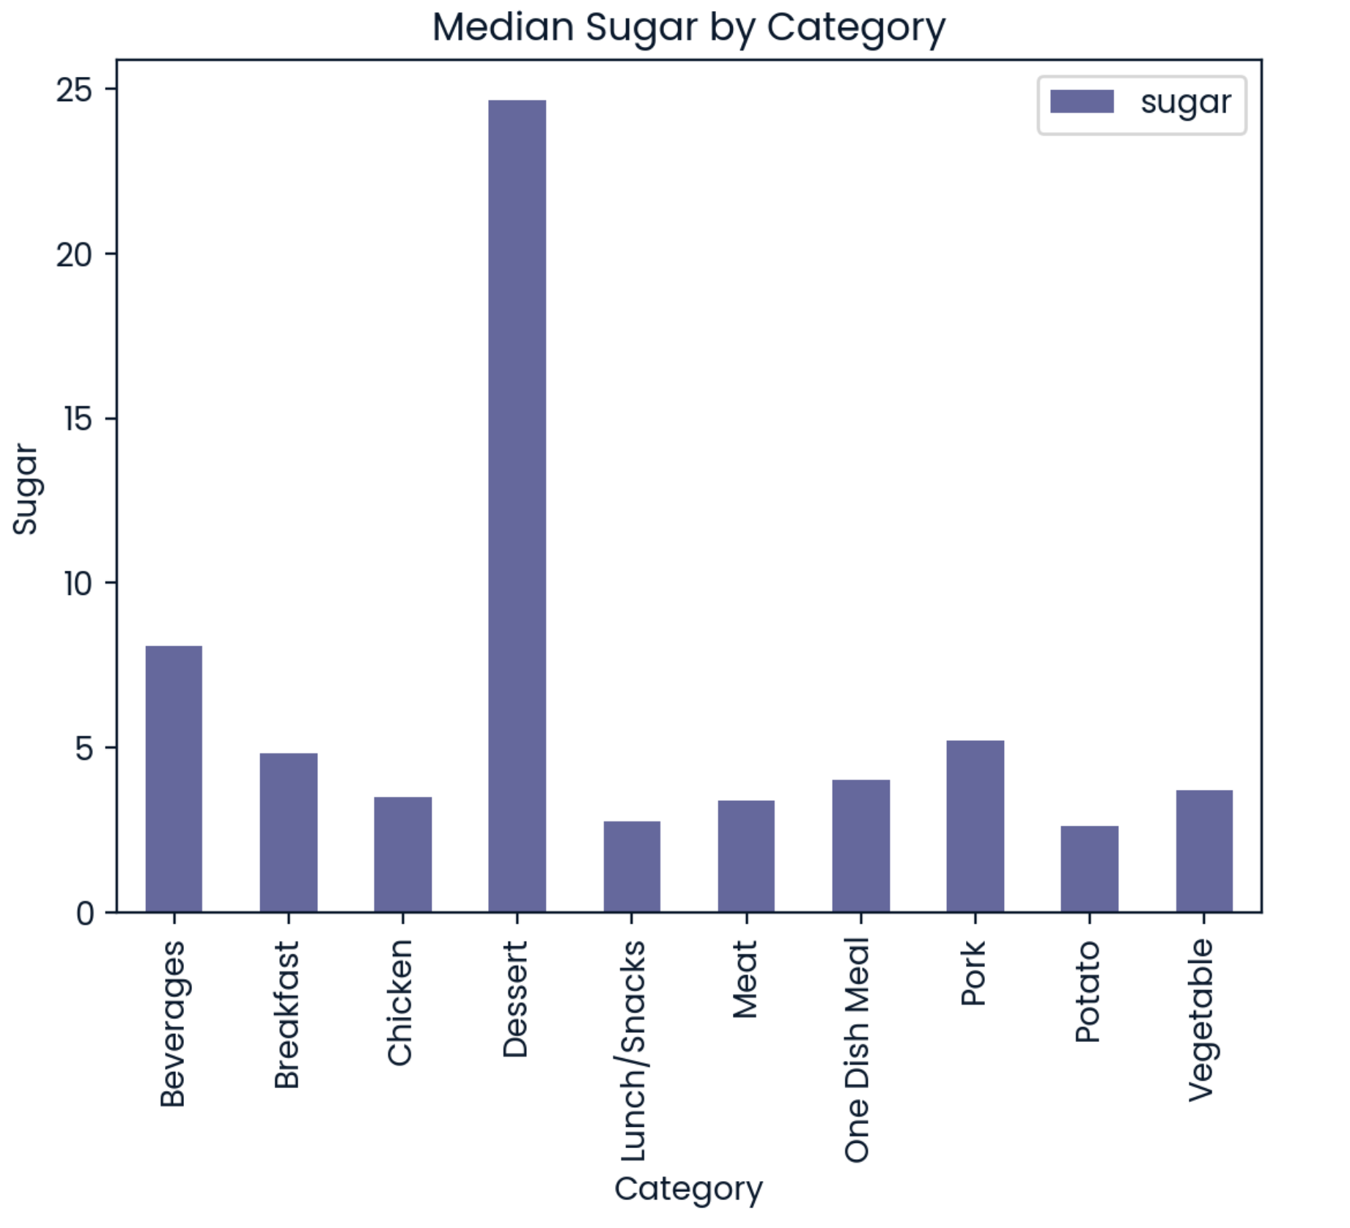
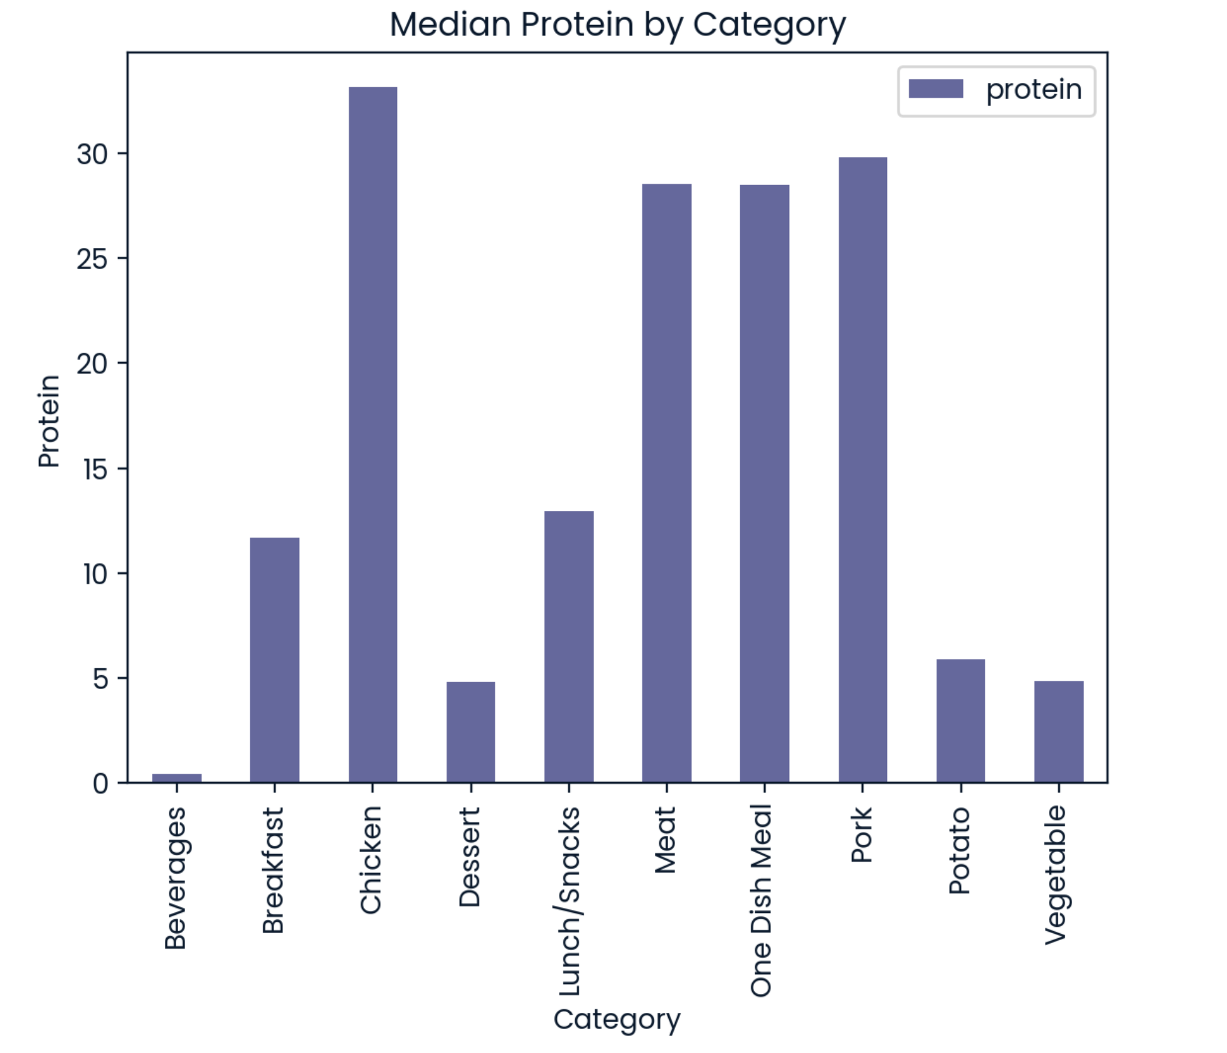
Exploratory Data Analysis

Slide 5
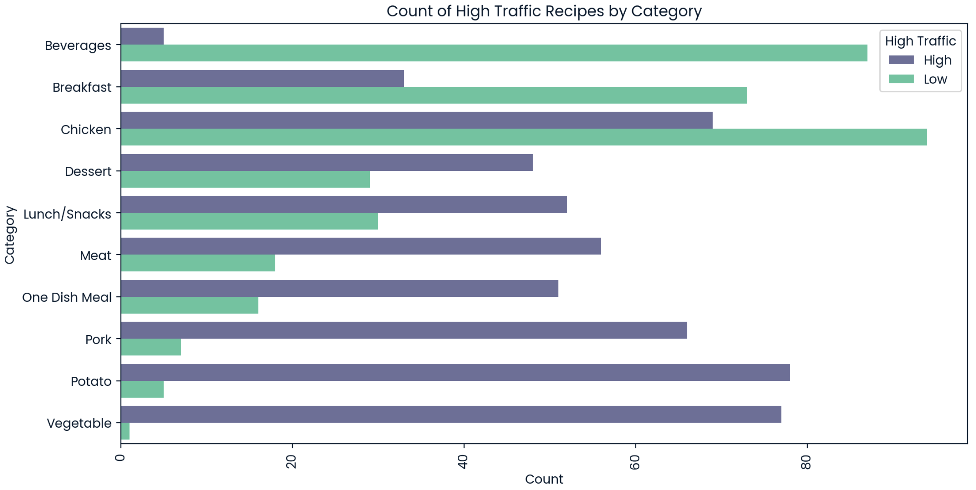
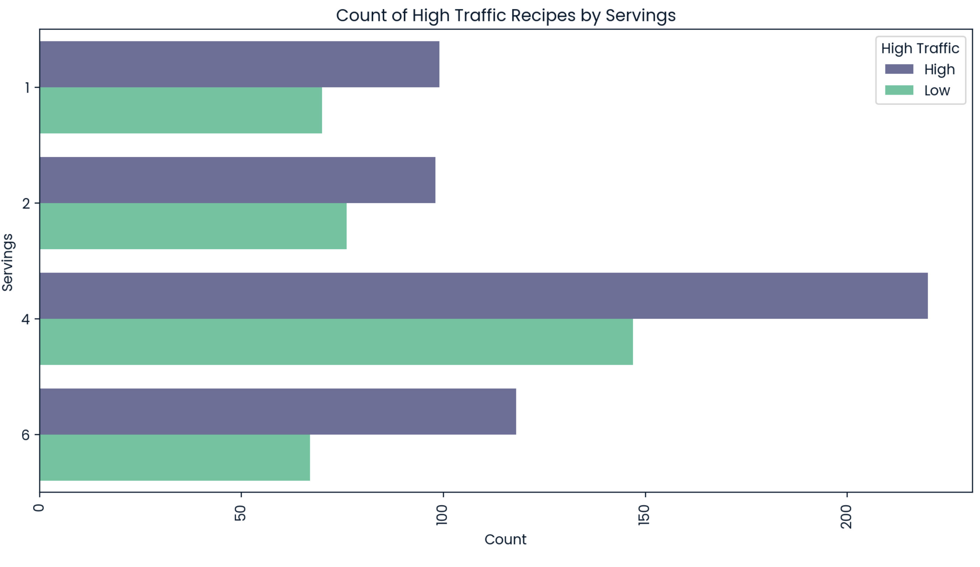
Key Findings

Slide 6
Model Development & Evaluation
Tested model performance on 4 machine learning models.
Best Model: Support Vector Classifier (SVC)
Accuracy: 77%
Key Metric to Monitor: Model Precision
Current Estimation:
The SVC model predicts high-traffic recipes with 77% accuracy, focusing on high precision to minimize significant errors.

Slide 7
Strategic Recommendations
1. Content Strategy:
Feature High-Traffic Categories: Prioritize "Vegetable," "Potato," and "Pork" recipes on the homepage and promotional content.
Avoid Low-Traffic Categories: Limit featuring "Beverages" recipes to reduce the risk of low engagement.
2. Model Improvement:
Aim to enhance the model to achieve 80% accuracy in predicting high-traffic recipes.
Regularly update the model with new data to maintain and improve prediction accuracy.
3. Monitor and Adjust:
Continuously monitor the model’s precision and accuracy to ensure it aligns with business goals.
Adjust the content strategy based on model predictions and real-world performance.

Slide 8
Achieving Business Goals
Predict High-Traffic Recipes:
Current Capability: Yes, with 77% accuracy.
Goal: Enhance the model to reach 80% accuracy.
Correctly Predict High-Traffic Recipes 80% of the Time:
Current Status: Slightly below at 77%.
Action Plan: Further model tuning and data enrichment to meet the 80% target.

Slide 9
Conclusion
Summary:
The SVC model currently provides the best predictions for high-traffic recipes.
Focus on model precision to minimize significant business errors.
Next Steps:
Implement the current model for immediate improvements in content strategy.
Work on refining the model to achieve the desired 80% accuracy.
Regularly review and update the strategy based on new data and model performance.

Slide 10
Thank You!

